Slide 1
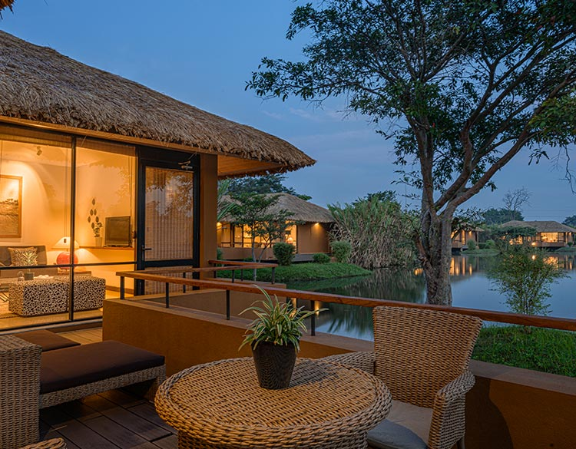
Natural Hotels

Slide 2
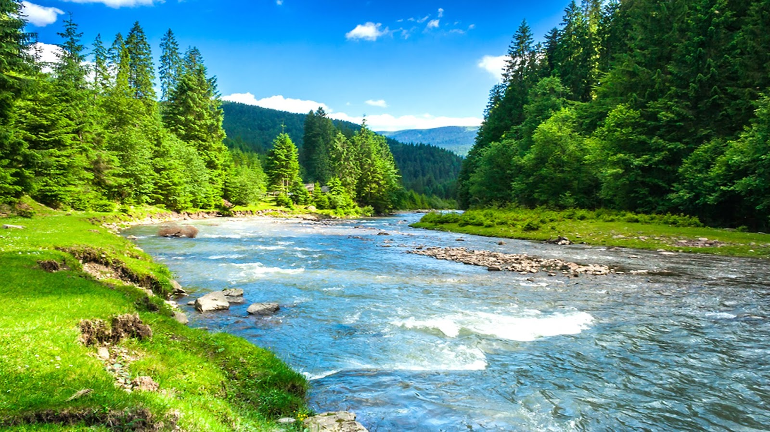
5 Group Members
SkyWalkers
13 pages

Slide 3
Our web site Process
Natural Hotels
Home
Contacts
About Us
Vacation
Day Out
Beachside Hotels
Riverside Hotels
Forestside Hotels
Mountainside Hotels
Beachside Hotels
Riverside Hotels
Forestside Hotels
Mountainside Hotel

Slide 4
Compere Hotels Packages
Different Location
Offers
Basic details about hotel

Slide 5
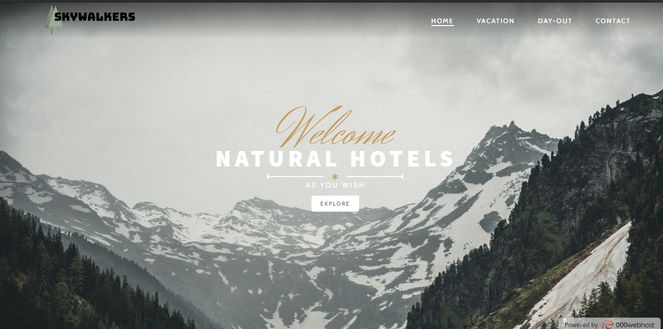
Main Web Page

Slide 6
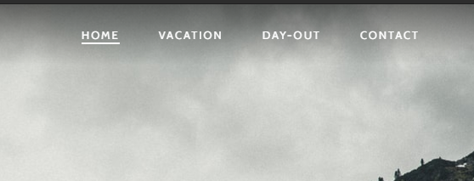
Sub Main Web Pages
Natural resorts and hotels to spend Vacations.
Natural resorts and hotels to spend
Day-Outs.

Slide 7
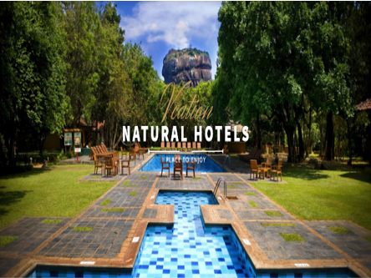
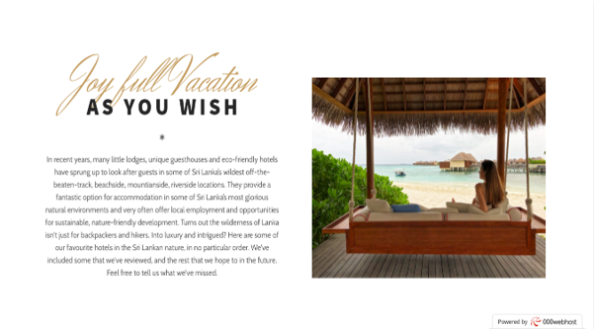
Vacation Web Page

Slide 8
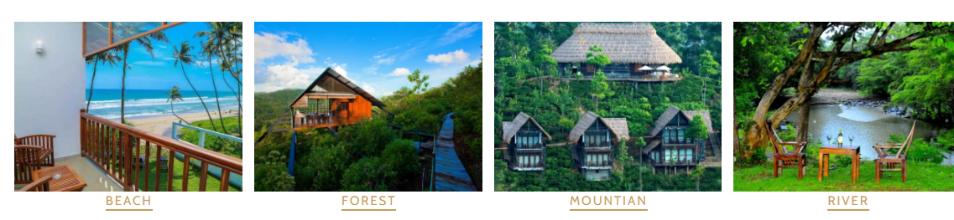
Through the Vacation web page..
Cheap amount natural hotels and luxury hotels also
Very comfortable packages
Visitors can make different choices as they wish from -:

Slide 9
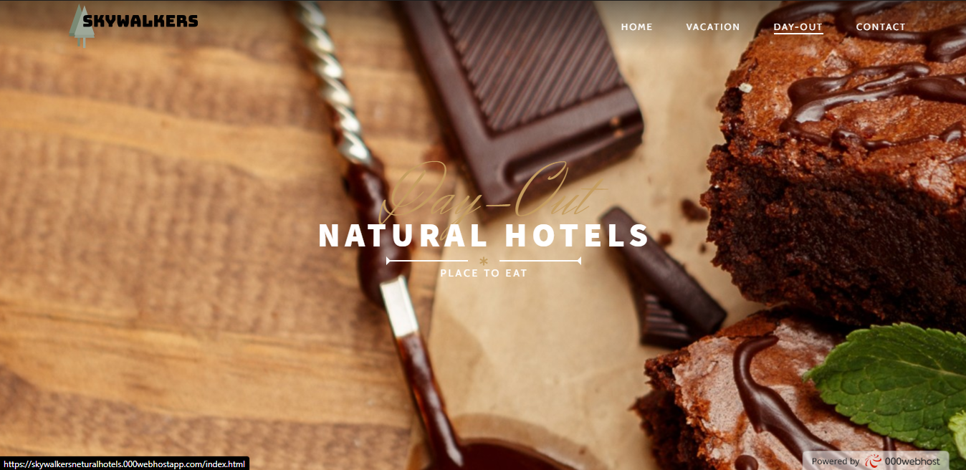
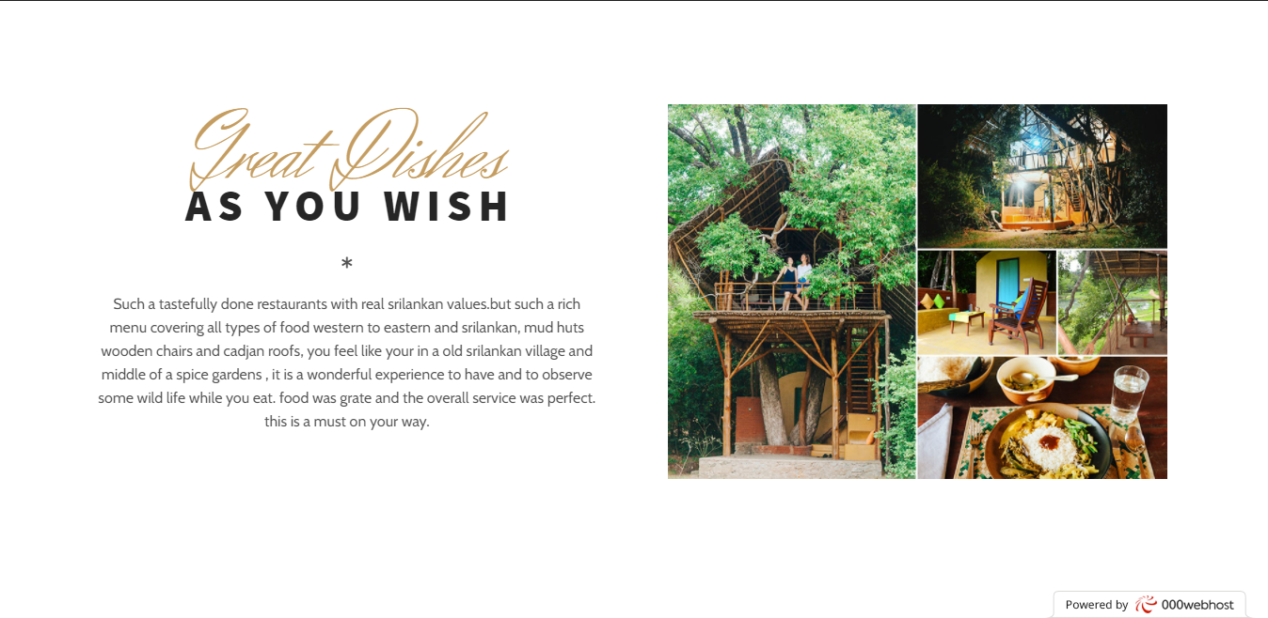
Day-Out Web Page

Slide 10
Through the Day-Out web page..
Very delicious meals
Surprise parties, Birthday parties..
Have the meals with nature
Visitors can make different choices as they wish from -:

Slide 11
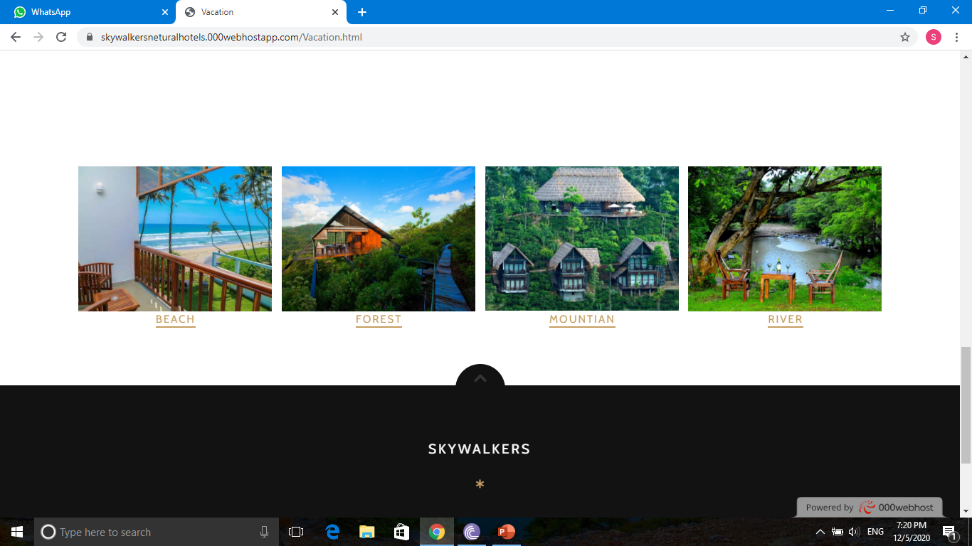

Slide 12
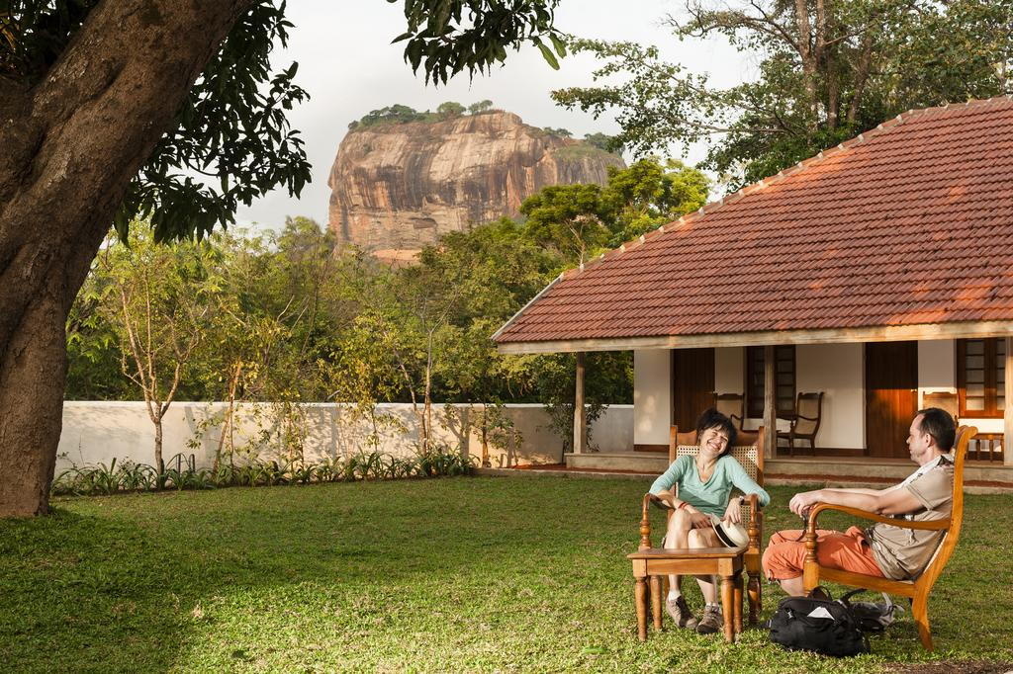
Vacation

Slide 13
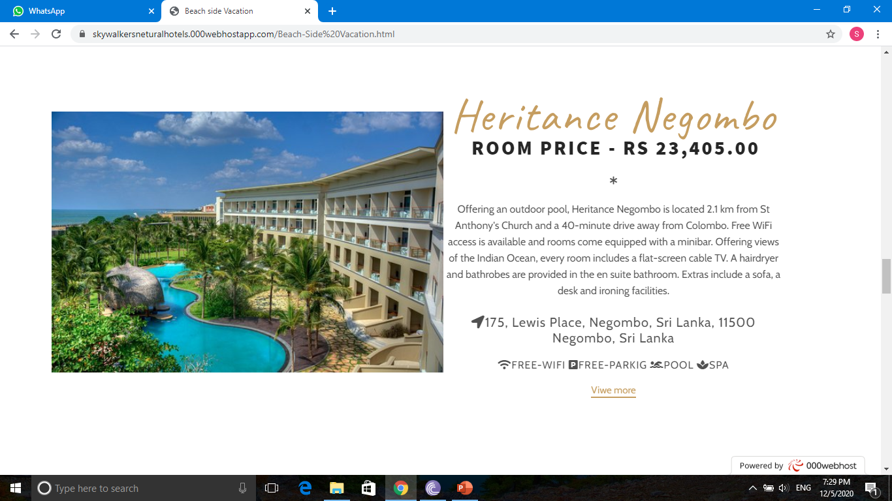
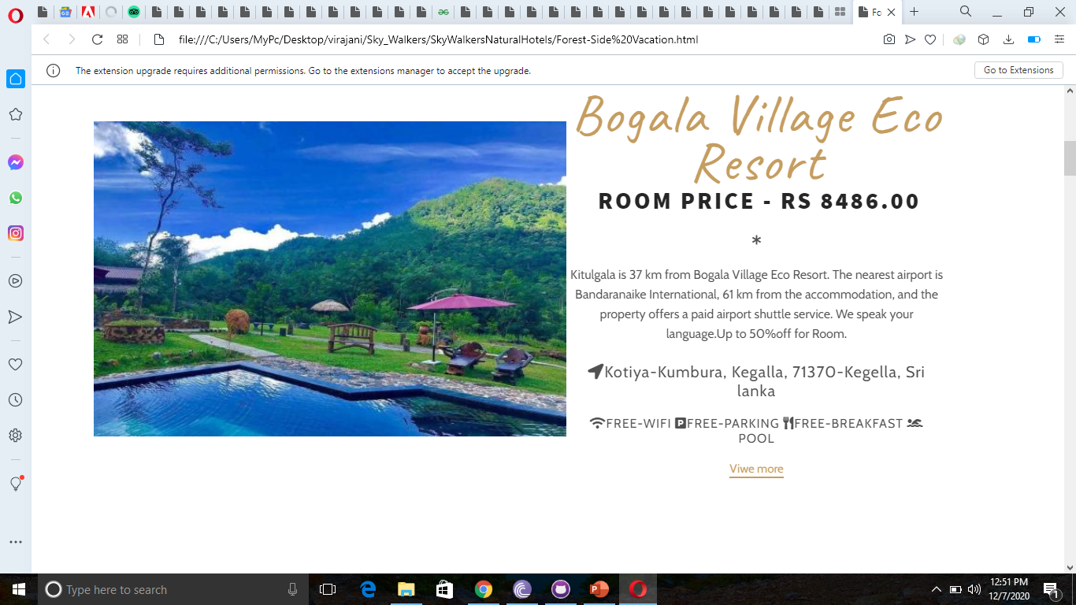

Slide 14
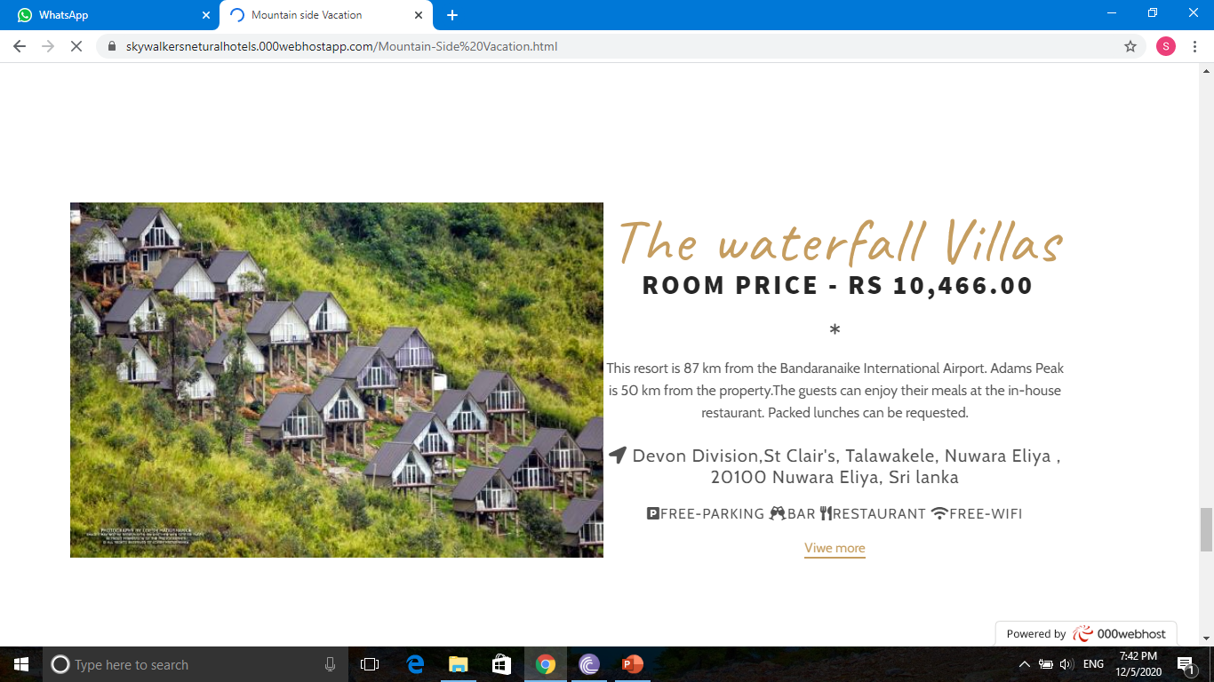
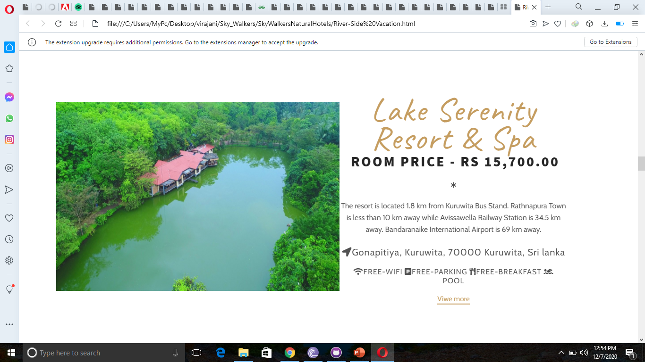

Slide 15

Day Out

Slide 16
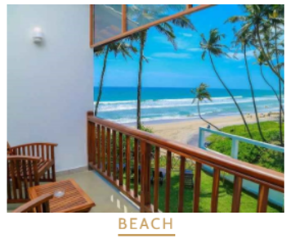
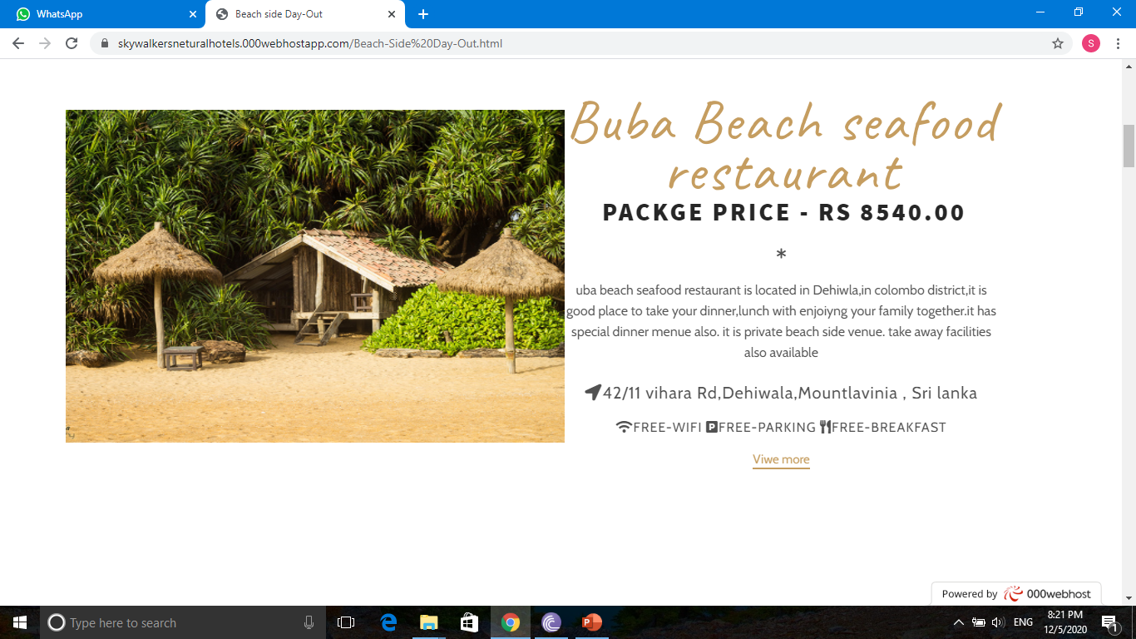
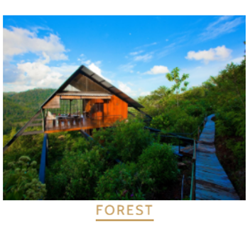
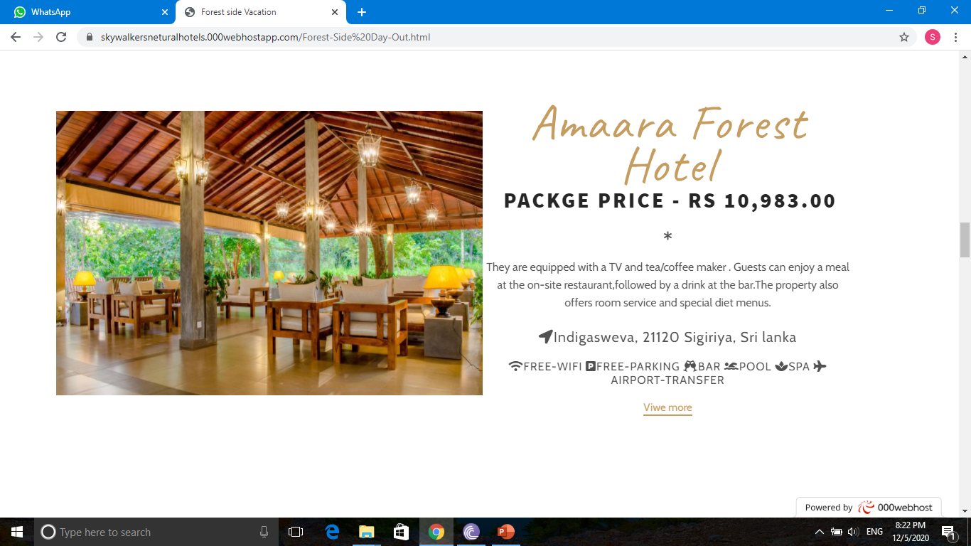

Slide 17
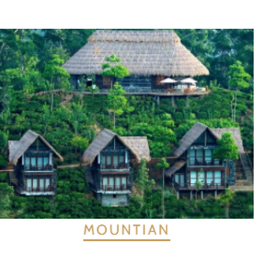
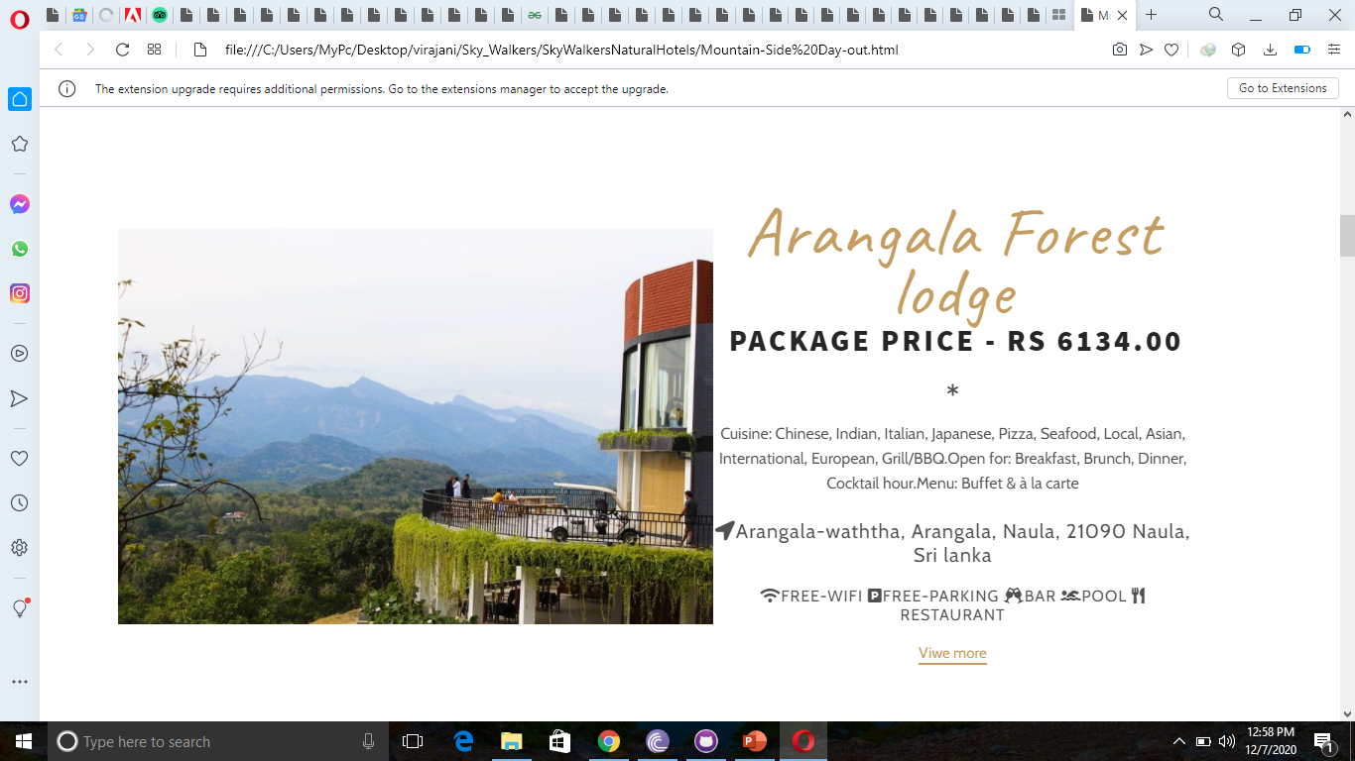
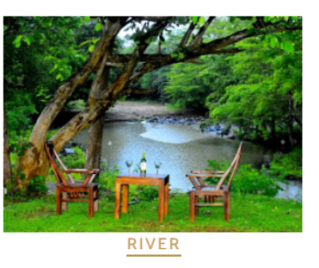
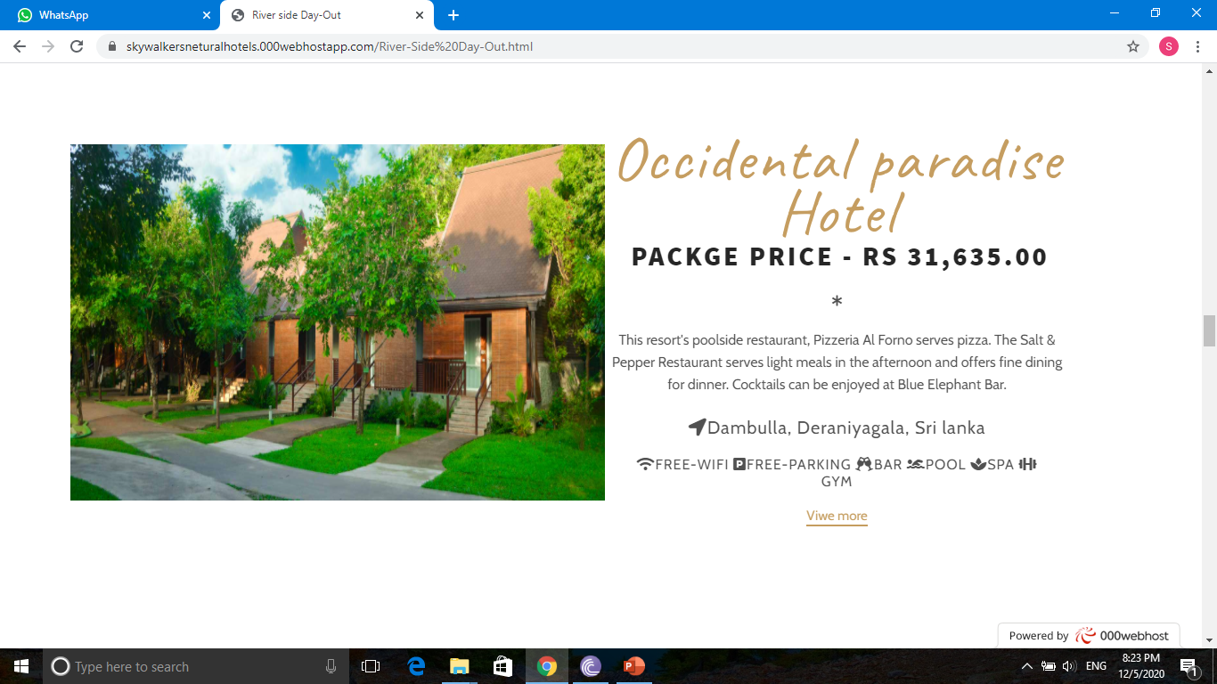

Slide 18
The Importance of our Web site
Easy to find nature hotels suitable for nature lovers for vacation and day out.
Depending on the individual, it can be selected as beachside hotels, riverside hotels, mountain side hotel and forest side hotels.
Quickly and easily gain an understanding of room prices, packages prices, packages details, facilitate and other details.
Consumer time and labor savings.
Very attractive and appealing.
Being able to choose the perfect choice for the most comfortable accommodation.

Slide 19
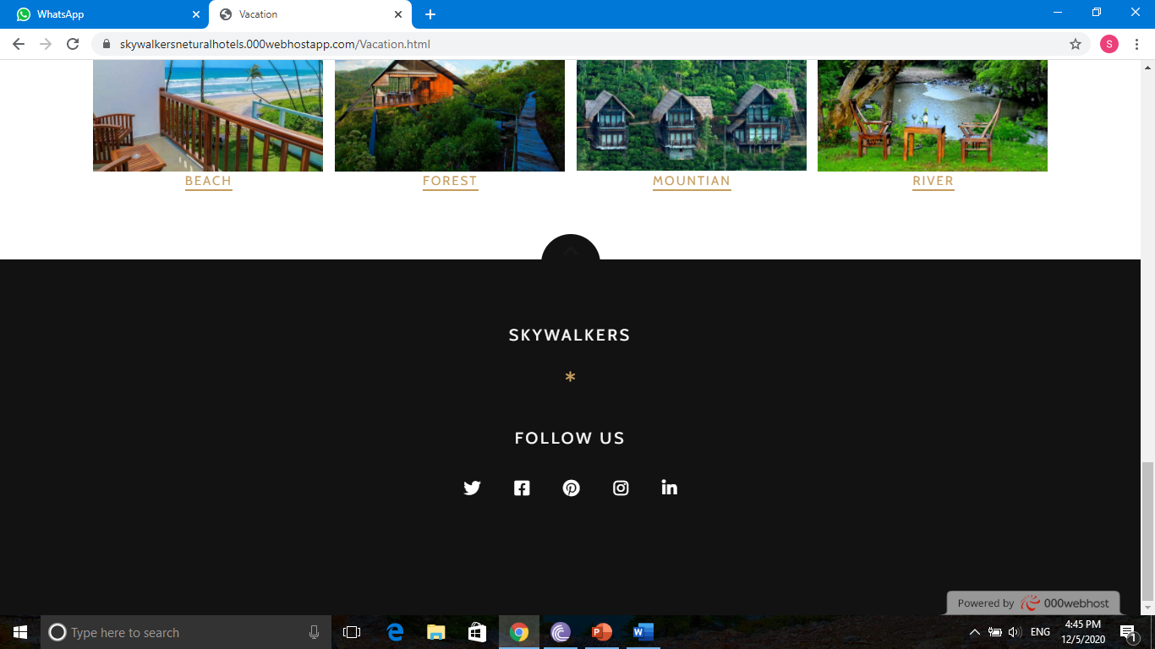
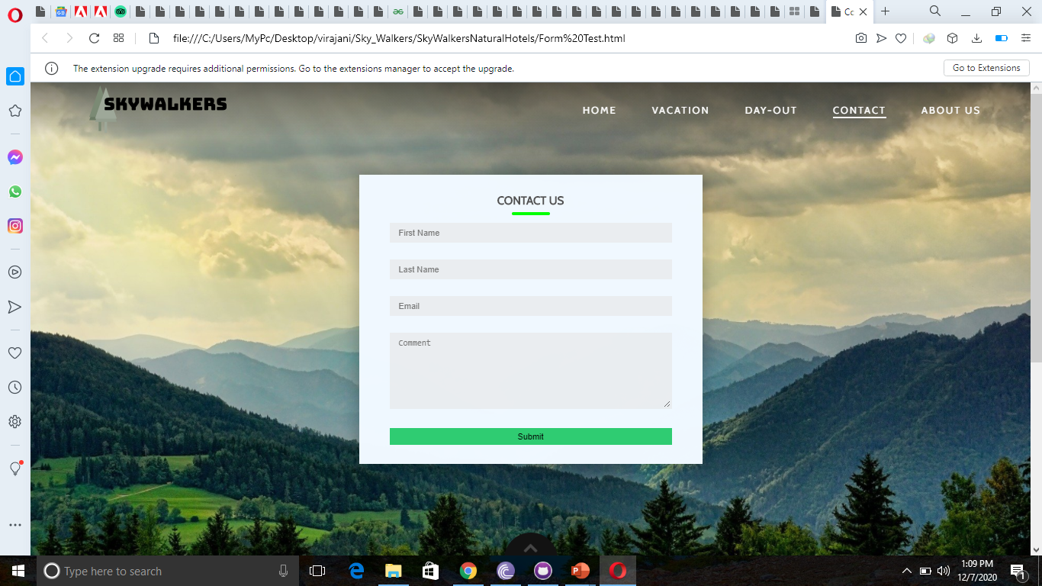
Contact Us
Email Address
Phone Number
Form
Face book

Slide 20

IMPROVEMENTS
If we talk about our future improvements in our Skywalkers hotel website ,we will hope to develop in different features and resources. Adding the feature of directly booking to a vacation or day out place according to that the user choice. In this situation our website have around fifty vacation and day out places and we hope to develop this website in wide area including whole country. We hope to improve new updates of our website for our new users. We hope to inform offers that gives the hotels included in our website for our users. We will develop our website 100% user friendly online booking engine and make easier to access for our daily users. We will develop the ability to compare and contrast room and rates

Slide 21
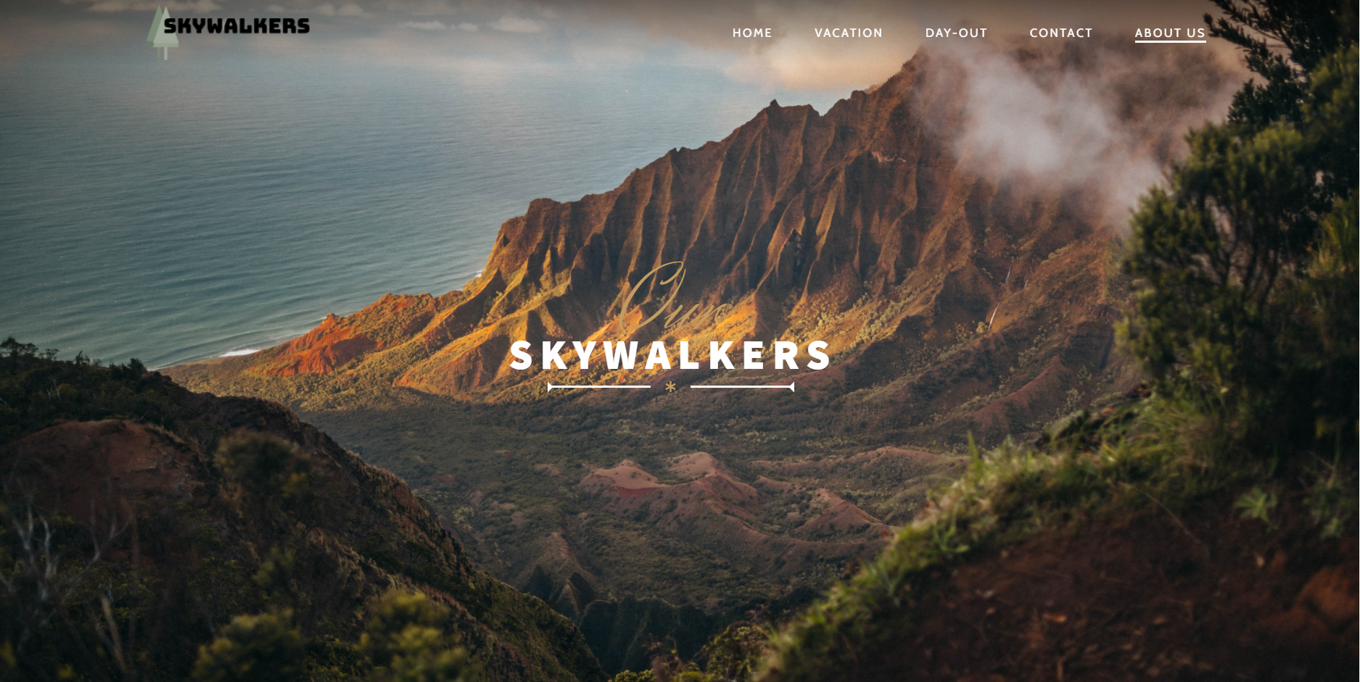
ABOUT US
We are hotel website developers and gang with 5 members .
Our website main purpose is to easier to find the vacation or day out place for the nature lovers .
There are four different environmental side included (river side, beach side, mountain side, forest side ) according to choose the place as people wish
We are user-friendly website and we had given the option that anyone can share the comments and mistakes to us and we will try to develop and implement Skywalkers website according to those comments
Our expectation is to develop Skywalkers website covering the whole country like wide area and included all the vacation places and inform instantly our users to the offers that gives each hotels.

Slide 22

Thank you

